Slide 1

Roles in a project team and software life cycles
Authors: Hubert Czerczer s3688
Maciej Basista s3524

Slide 2

Presentation plan
Introduction
Project team
- Project team structures
- Roles in project team
- Conclusion
Software life cycles
-Phases of software project
-Lifecycles models
-Conclusion

Slide 3
Introduction
The project team is the group of people responsible for planning and executing the project.
Project team is created in strategy phase.
Project team chooses life cycle model.

Slide 4
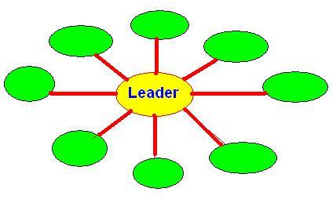
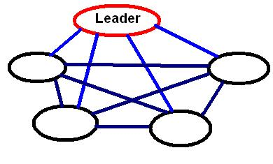
Project team structures
STAR structure
-Leader position(central)
-Leader assigns tasks
-Time absence – problems
For big project teams
NET structure
-Members have each other contact
-Leader doesn’t cooperates
-5 participants limit

Slide 5
Roles in project team
        Leaders – coordinators
        Analysts
        Designers
        Programmers
        Testers
        Organizers
        Administrators
        Documentators
        Integrators

Slide 6
Leader
      Controls whole group
      Tackles with team conflicts
      Coordinates team
      Uses team resources
      Self confident

Slide 7
Analyst
      Creates system model
      Contacts with customer
      Analyzes problems
      Makes suggestions

Slide 8
Designer
    Depends on analyst job
    Implementation description
    Cooperates with programmers
    Specialised(i.e. database, user interface)

Slide 9
Programmer
Programming language skills
Experience
Imagination
Cooperation with other programmers

Slide 10
Tester
        Makes reports
        Checks errors
        Checks functionality

Slide 11
Team-work atmosphere
Work atmosphere is very important, has a big influence on team-work performance.
Leader should strongly cooperate with all team members.
It’s very important to maintain
a good teamwork to achieve success.

Slide 12
SOFTWARE
LIFE CYCLES

Slide 13
Life cycles models
What is software production?
What we need models for?

Slide 14
PHASES
        strategy
        requirements elicitation
        analysis
        requirements
        design phase
        implementation
        integration
        testing
        documentation
        installation
        operations and maintenance

Slide 15
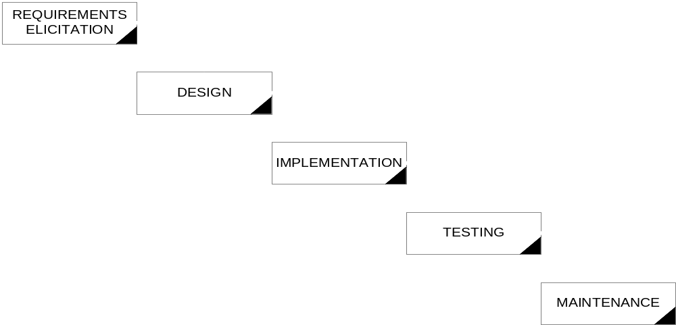
WATERFALL MODEL

Slide 16
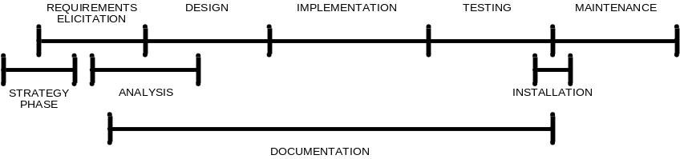
WATERFALL MODEL

Slide 17
WATERFALL MODEL
advantages:
ease in project managing
easy planning, scheduling, monitoring
disadvantages:
force the exact order of work
high cost of the possible mistakes made in the first phases
long brake in the contacts with client

Slide 18

WATERFALL MODEL WITH ITERATIONS

Slide 19
DOCUMENT-DRIVEN
Developed by US Army
Kind of waterfall model
Documentation after every phase

Slide 20
DOCUMENT-DRIVEN
Advantages:
theoretical possibility to change the programmer in the middle of the process of production
Disadvantaged:
lots of time necessary to prepare documentation consistent with the standards (DOD STD 2167)
breaks in the realization for the document verification by client

Slide 21
PROTOTYPING
Phases:
  general requirements elicitation
  building prototype
  prototype verification by client
  full requirements elicitation
  full system realization according to the waterfall model
Goals:
  detect the misunderstandings
  detect the missing functions
  detect difficult services
  detect minuses in the requirements specification

Slide 22
PROTOTYPING
Prototyping methods:
  partial realization
  high-level programming languages (Smalltalk, LISP, Prolog, 4GL)
  usage of ready components
  User Interface generators
  “quick-and-dirty”

Slide 23
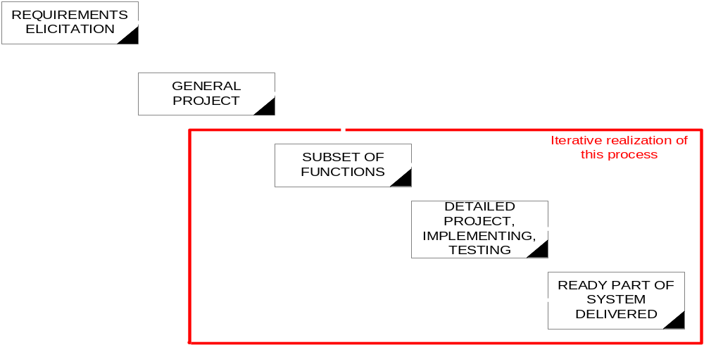
INCREMENTAL DEVELOPMENT

Slide 24
COMPOSITION OF RE-USABLE COMPONENTS
Advantages:
  high reliability
  smaller risk
  effective utilization of specialists
  usage of standards
Disadvantages:
  additional cost of preparation re-usable components
  dependence on the components deliverer
  lack of tools supporting this kind of work

Slide 25
SPIRAL MODEL
PLANNING
RISK ANALYSIS
ATTESTING
CONSTRUCTION

Slide 26
SUMMARY
Other models:
exploratory programming
formal transformations
THERE IS NO PERFECT SOLUTION!

Slide 27
Sources
1. J. Płodzień, E. Stemposz: “Analiza i projektowanie systemów informatycznych”, wydawnictwo PJWSTK
2. Wikipedia
3. Andrzej Jaszkiewicz ‘Inżynieria Oprogramowania CASE’, Helion 1997
4. Other internet sources

Slide 28
If You have any questions please contact us:
Maciej Basista – maciek@pjwstk.edu.pl
Hubert Czerczer – s3688@pjwstk.edu.pl
Thanks for attention

